Slide 1
WP4 – Knowledge base Design and Implementation
Prof. Dr. Geylani Kardas (KocSistem)

Slide 2
WP4 Knowledge Base Design and Implementation
Design and implement the ModelWriter’s:
federated Knowledge Base itself, hosting multiple formalisms.
bi-directional text-model synchronization mechanism.
required API
a set of specialised modules (plug-ins) that exploit the Knowledge Base in ways that make the tasks of Technical Authors much more productive, e.g. consistency checks.
the collaborative functions linking and hierarchically organizing multiple ModelWriter KBs used by different Technical Authors on different sites.

Slide 3
WP4 Knowledge Base Design and Implementation
Plug-in #1 – This provides consistency and completeness checks within the same software lifecycle document, allowing automatic quality review of the content (meaning).
Plug-in #2 – This provides consistency and completeness checks between related set of documents.
Plug-in #3 – This provides semantic comparison between two versions of the same software lifecycle document (i.e. what conceptual changes have happened).

Slide 4
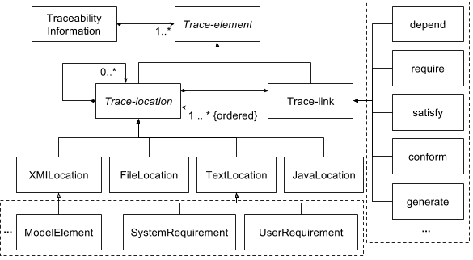
ModelWriter Core Model Approach

Slide 5
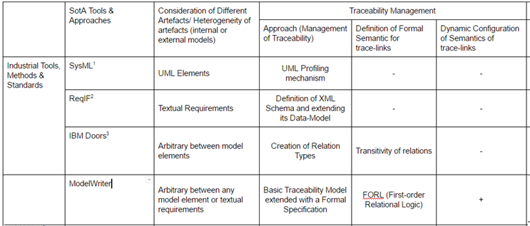
ModelWriter Core Model State-of-the-art

Slide 6
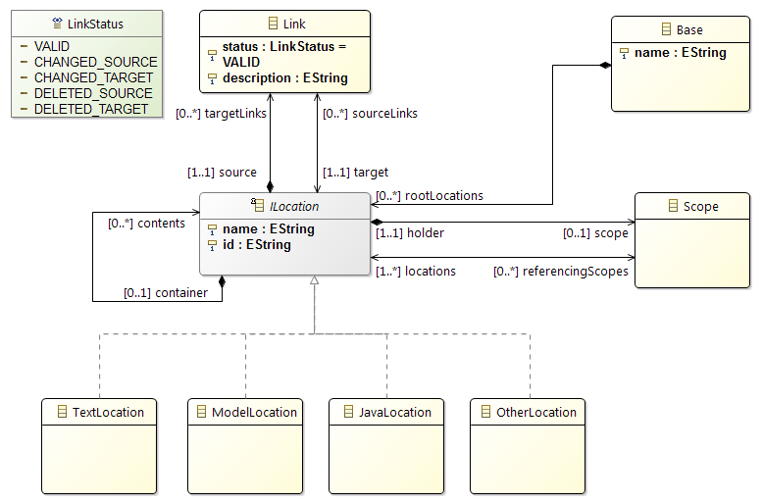
ModelWriter Core Model Implemented by OBEO

Slide 7
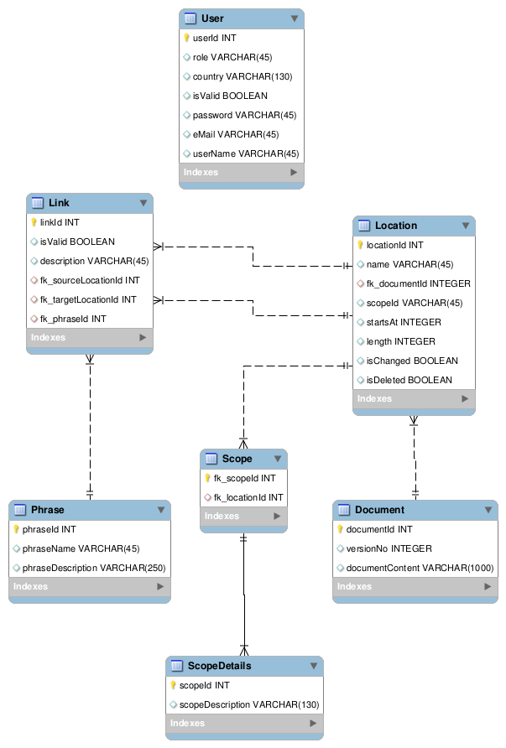
Knowledge-base Design
The class diagram of the knowledge base data structure representation.
MANTIS has prepared D4.1.1 Knowledge Base Design Document.
This document still is open to edit and to add contributions.

Slide 8
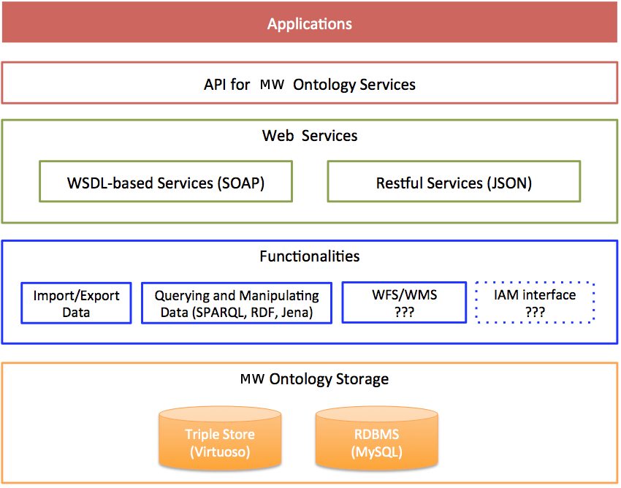
Ontology Infrastructure Knowledge-base Implementation Ontology Infrastructure
WMS/WFS services: standardized by Open Geospatial Consortium to use geographical attributes.
IAM interface for identification and access management. Current platform uses OAuth2 authentication system (http://oauth.net/2/)
Web Feature Services (WFS)/Web Map Services (WMS) may be partially implemented.
Identity and access management (IAM) services may not be implemented at all.

Slide 9

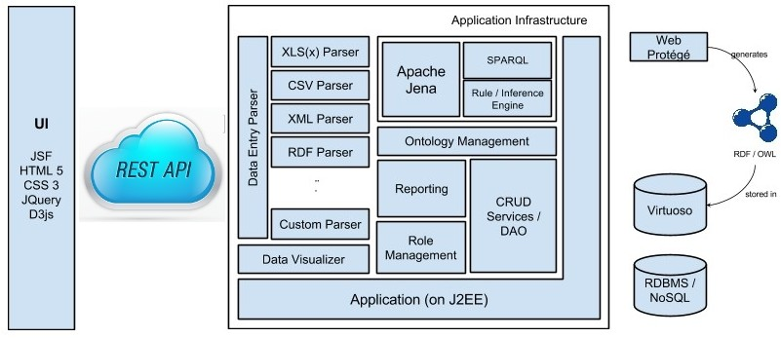




Knowledge-base Implementation Ontology Infrastructure
The requests that arrives via web services are stored as triple in the Virtuoso Ontology Database and can be queried.
All processes that are based on ontology are done in Ontology Management Module (OMM).
OMM is set up on parent Jena framework and inference engine can be utilized efficiently with SPARQL queries.
Also by using Web Protégé ontology can be generated in RDF/OWL formats and that ontology can be stored in Virtuoso.

Slide 10
Ontology Issues and Services
Ontology Issues CRUD operations on ontologies as RESTFUL services Using a sample design document, Mantis designed a document ontology Ontology is hosted on Mantis servers Manual RDF export Automatically RDF export (working on) Ontology Services insertTriple: This method inserts a new triple into an ontology. ImportIntoOntology: This method imports triples into an ontology exportOntology: This method exports a specific ontology executeQuery: This method executes specific query dropOntology: This method drops a specific ontology removeTriple: This method removes specific triple(s)

Slide 11
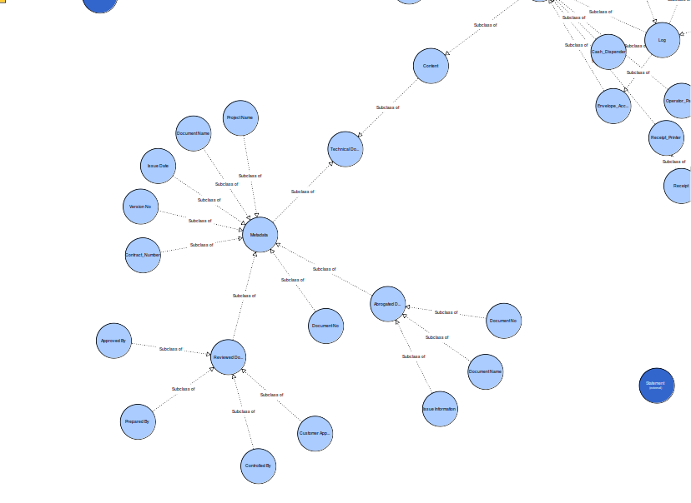
Sample Document Ontology Model

Slide 12
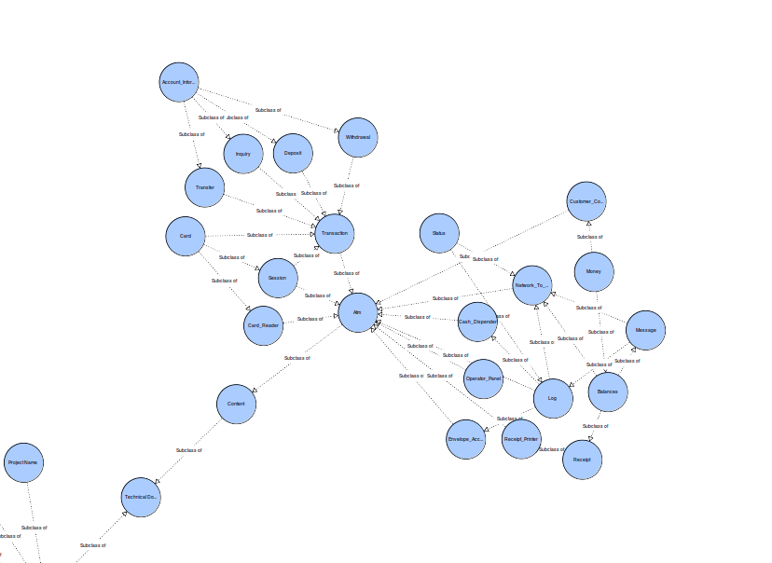
Sample Document Ontology Model Instance

Slide 13
Thank you for your attention We value your opinion and questions.

